Slide 1


GIT Together
tam.vit.vellore

Slide 2

Have you ever written a code, only to break everything later?
Maybe your file name was final_project_final.java
Backup_final(1).py

Slide 3
We’ll be exploring:
-How to track changes
-collaborate
-contribute to open source projects

Slide 4
Need to manage changes to your files?

Slide 5
Let’s Git it going

Slide 6






Confidential

Slide 7


GitHub Student Developer Pack
The GitHub Student Developer Pack is a special bundle of free tools
GitHub Copilot: An AI coding assistant to help you write code more efficiently.
Canva Pro: A design tool for creating professional-quality graphics.
Namecheap: Free domain name registration for your projects.
Cloud Services: Access to platforms like Replit, MongoDB Atlas, and Azure for hosting and development.

Slide 8


Understanding Git vs. GitHub
Git: Version Control System
GitHub: Hosting Platform
Git is a version control system that tracks changes in your code
GitHub is a hosting platform for your code files.

Slide 9
Git Installation and Setup
After installation of Git in your system, use GIT BASH for Windows and TERMINAL for Mac/Linux.
git config --global user.name "Your Name"
git config --global user.email "your-email@example.com"
git config --list

Slide 10

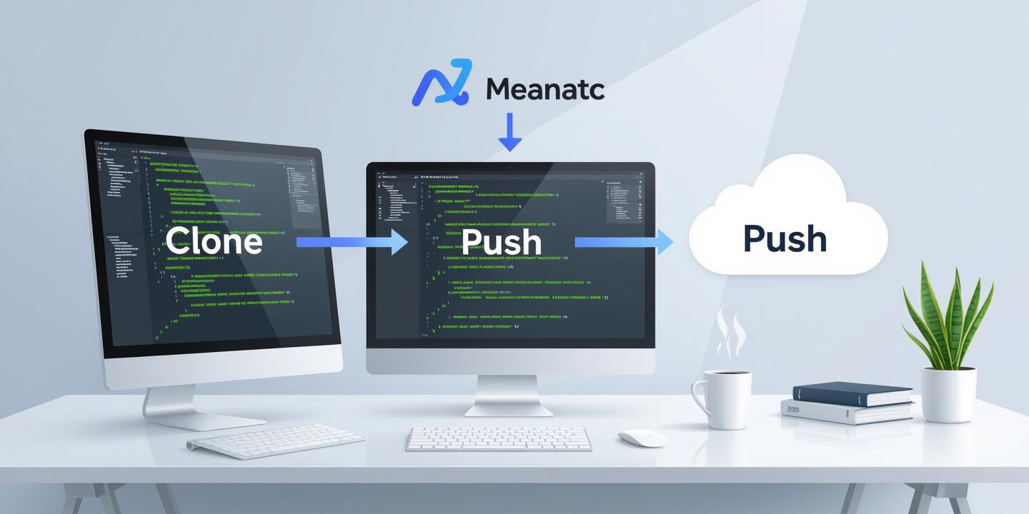

Key GitHub Terminology
Repository
Cloning and Pushing
Commit
A repository (or repo) is a storage location for your project.
Cloning creates a local copy of a repository from GitHub.
Pushing uploads local commits to the remote repository on GitHub.
A commit is a snapshot of your project at a specific point in time.

Slide 11
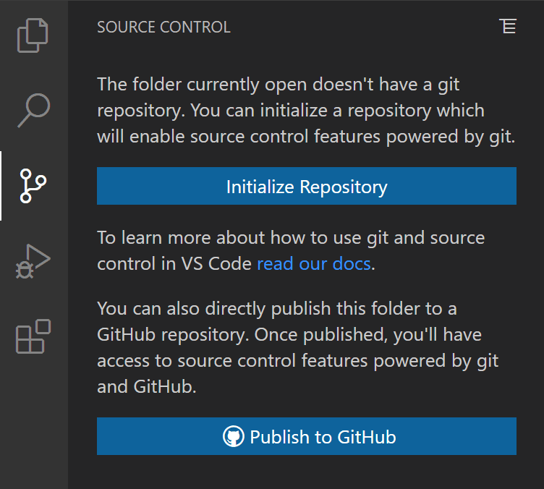
GIT Commands and VS code integration
Source Control Tab
“Initialize Repository.”
.git stores all the change history.
You can stage the file by clicking the little plus icon next to it.
Write a commit message — something like “Initial commit with index.html.”
Click the checkmark or press Ctrl + Enter.

Slide 12
How to push changes made locally to GITHUB
Create repo on GitHub → Click New, name it (e.g., git-demo), don’t add README or .gitignore.
Copy HTTPS URL from the created repo.
Link local repo to GitHub in VS Code terminal:
git remote add origin <paste-URL-here>
Set branch name to main: git branch -M main
Push code to GitHub: git push -u origin main

Slide 13
Profile

Slide 14
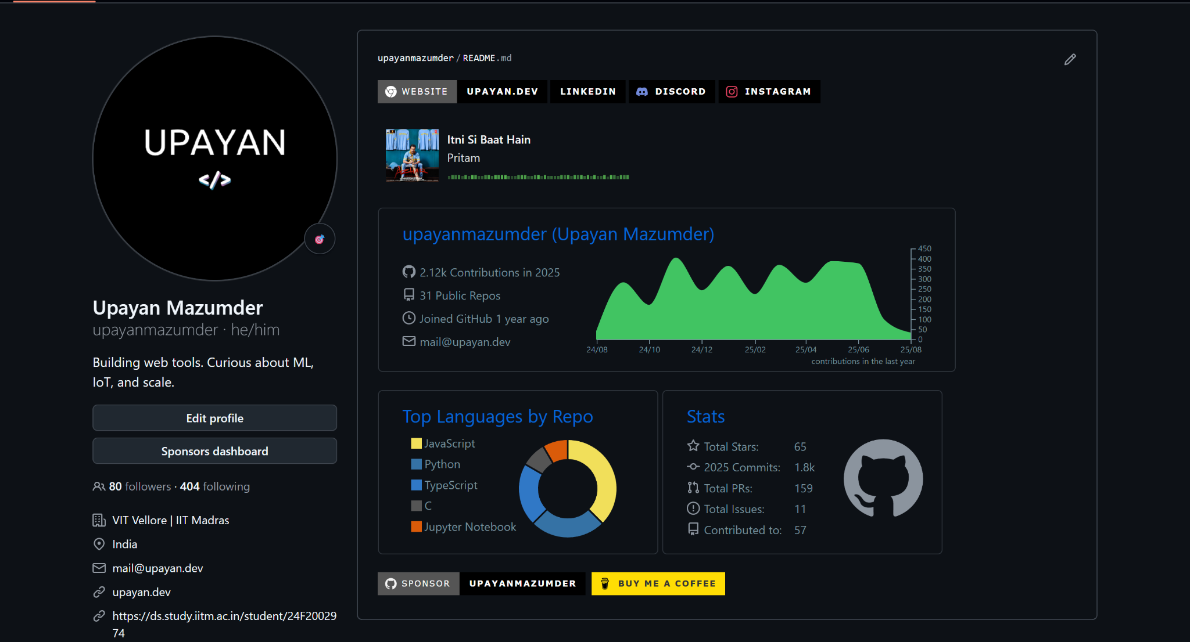
Profile README.md

Slide 15
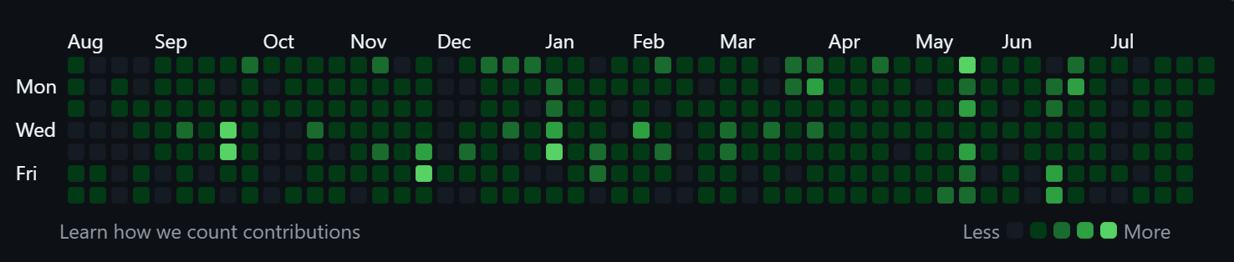
Contribution graph
Consistency > Quantity

Slide 16
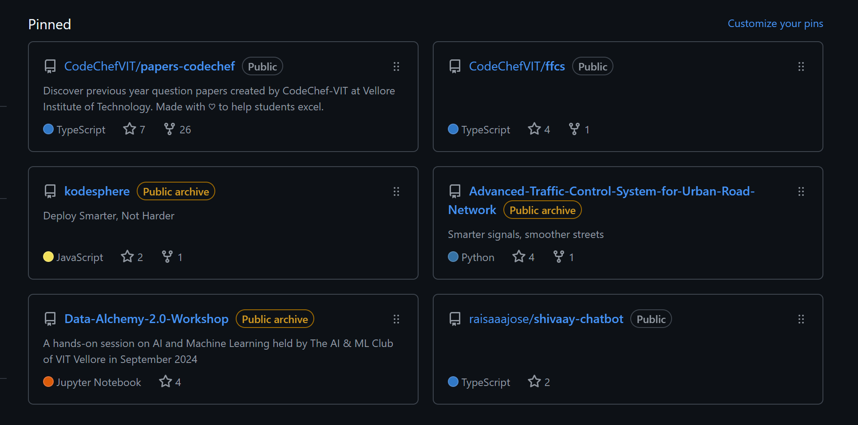
Pinned repos
Projects = Portfolio

Slide 17
Branches

Slide 18
>> Branch: safe testing space
>> Create branches like feat-<feature>
>> Merge when ready

Slide 19
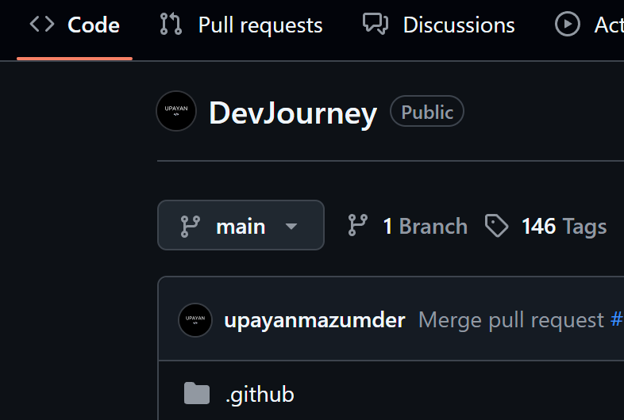
Default Branch: main

Slide 20
Pull Requests

Slide 21
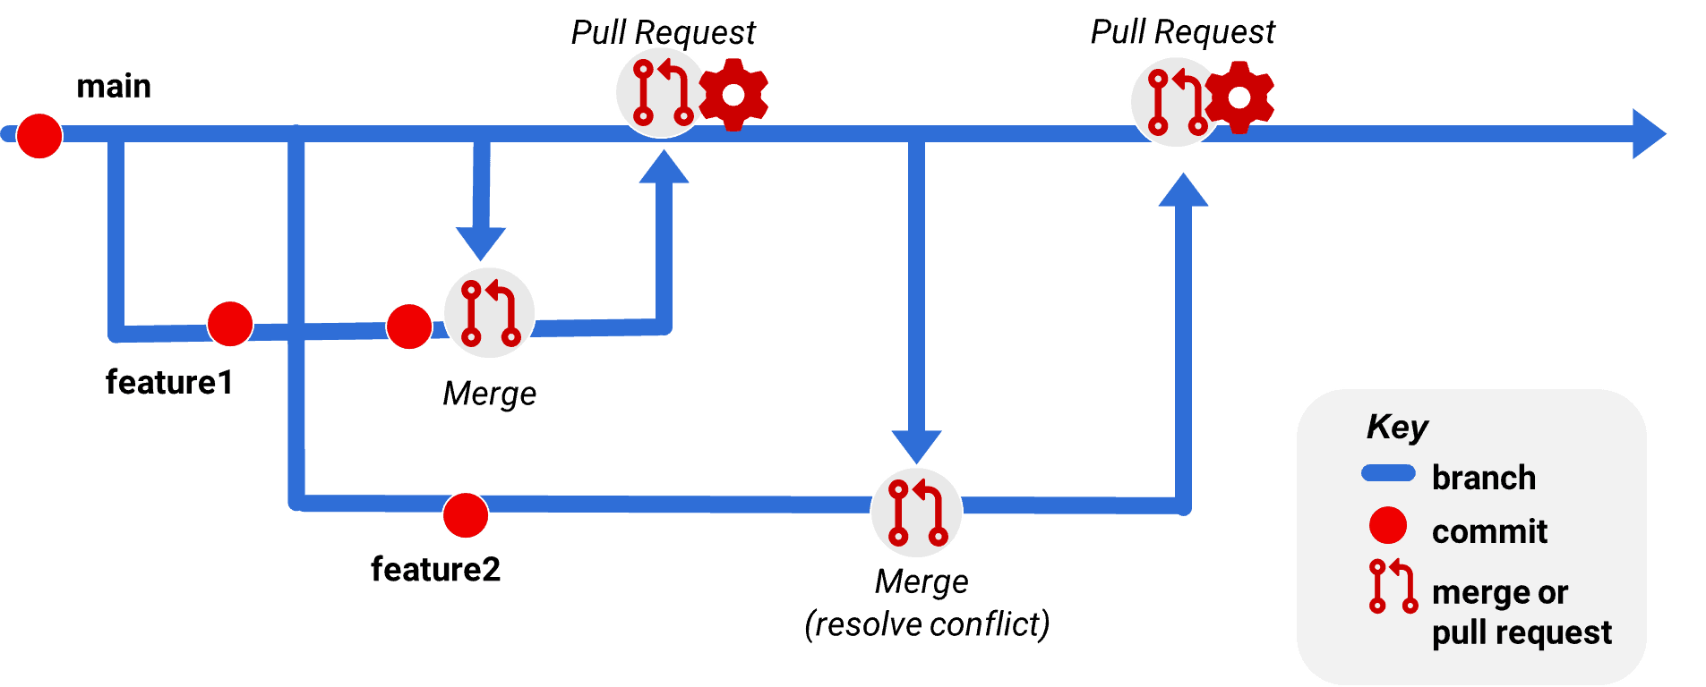

Slide 22
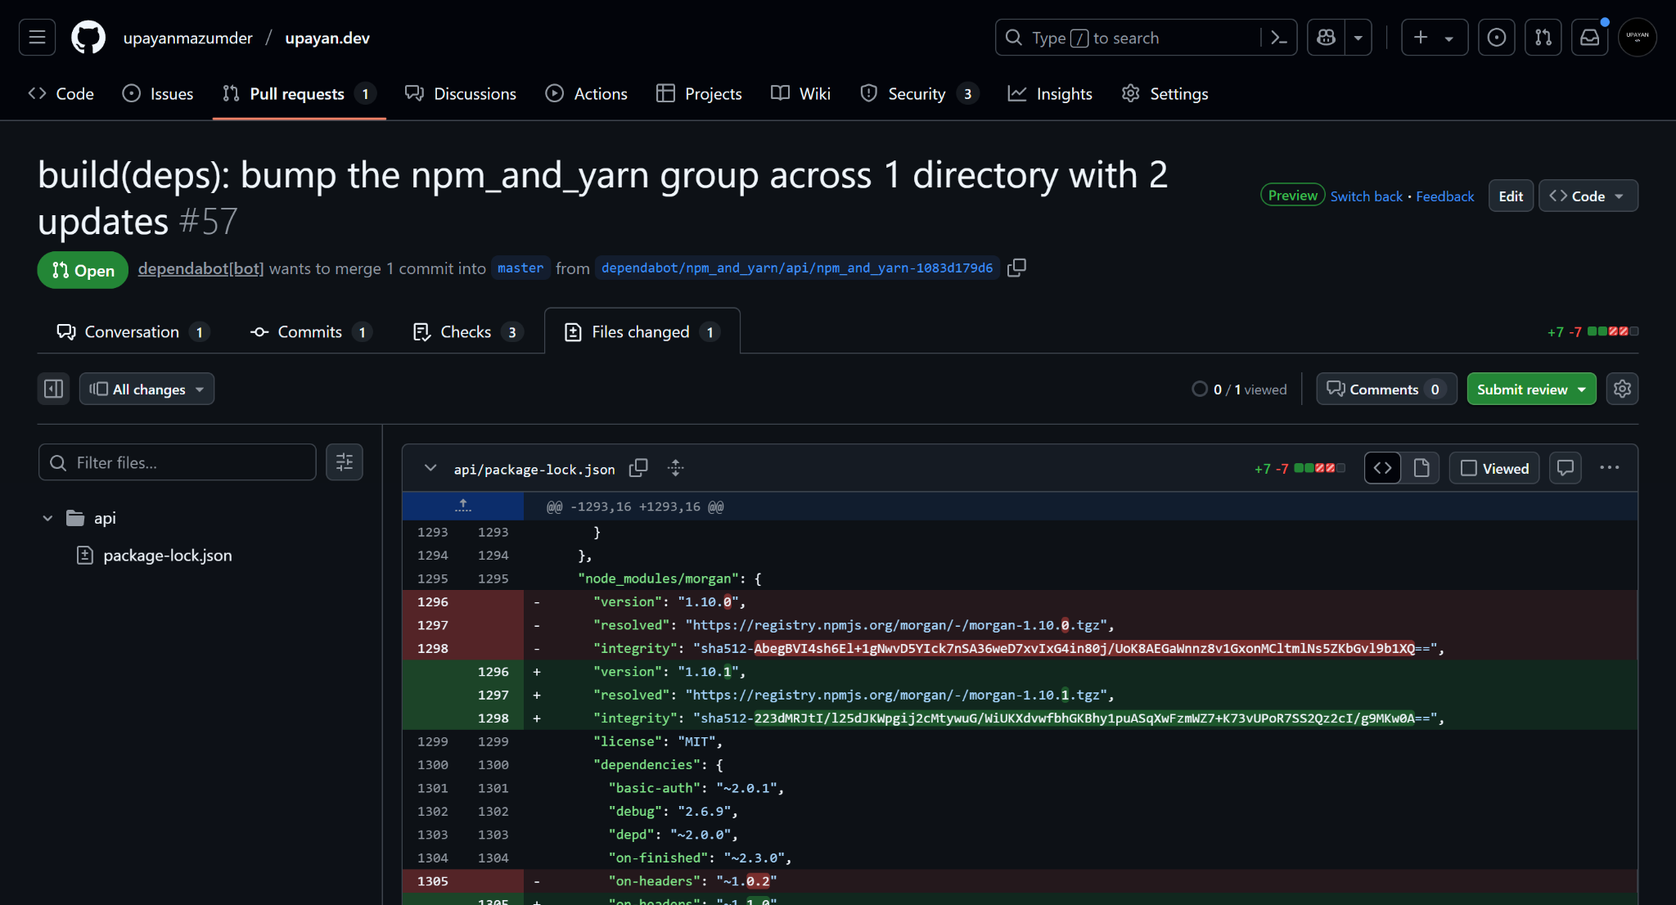

Slide 23
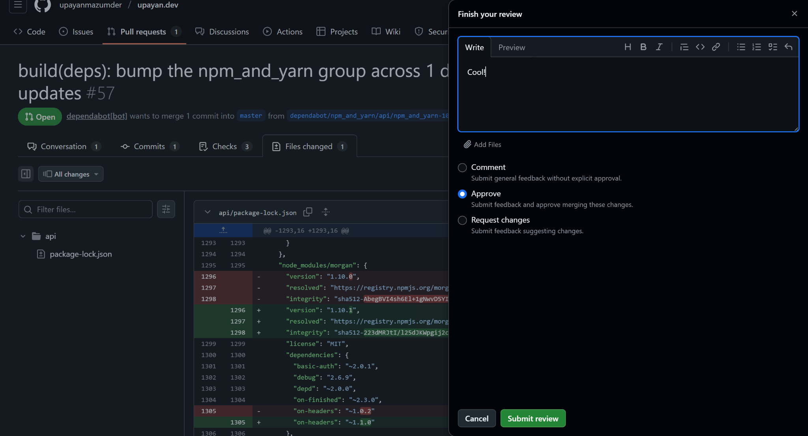

Slide 24
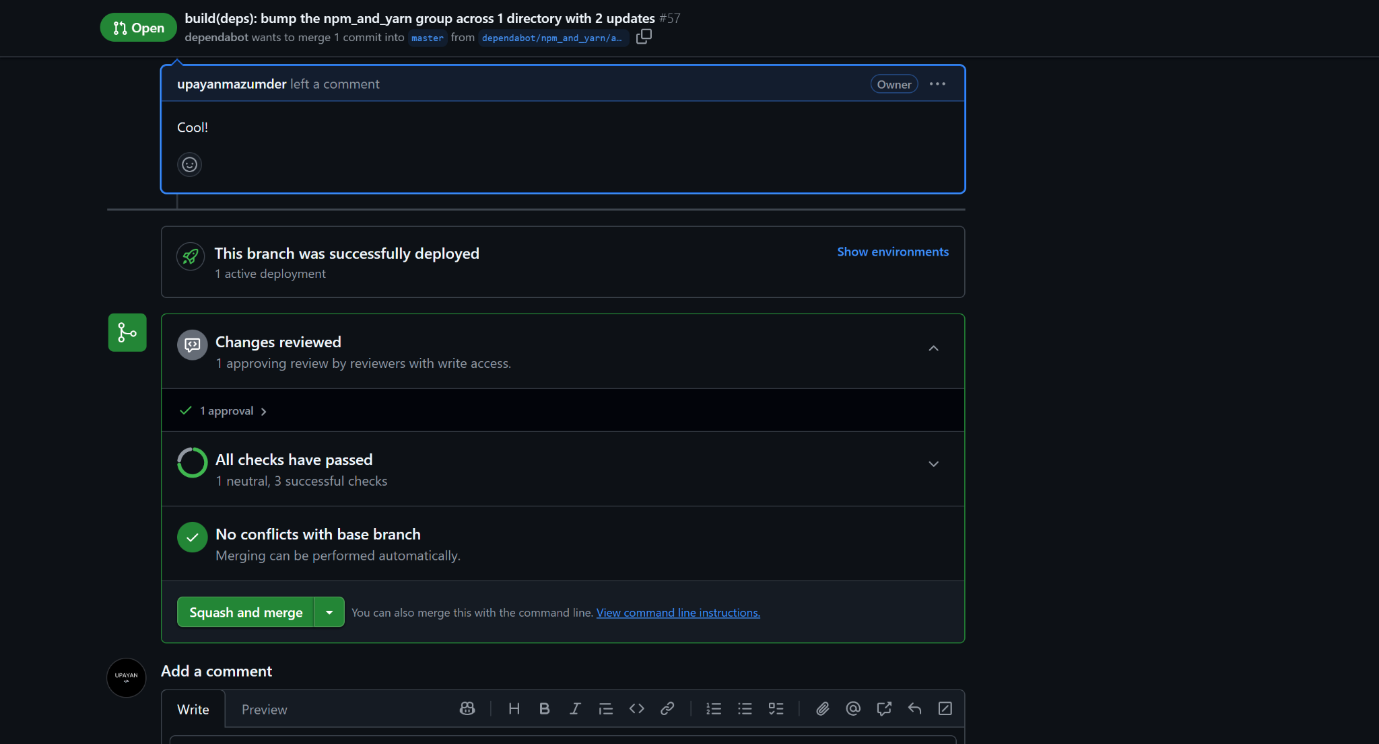

Slide 25
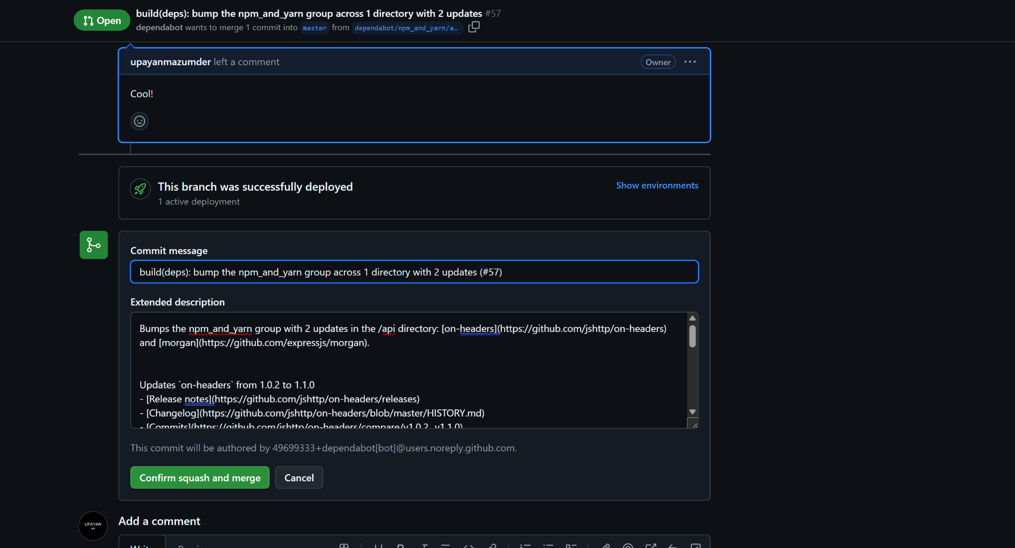

Slide 26
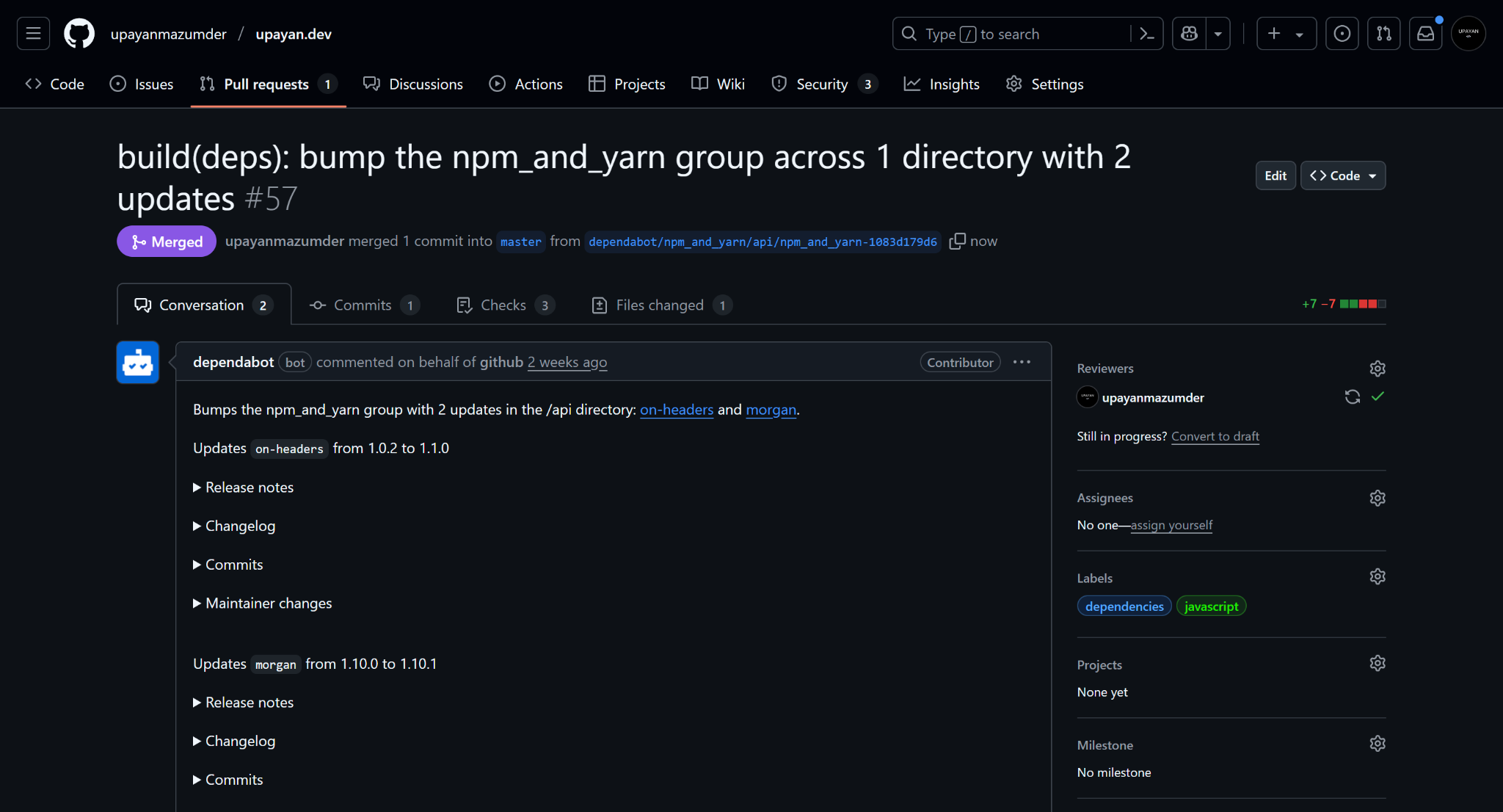

Slide 27
Read more about pull requests
docs.github.com/en/get-started/using-github/github-flow

Slide 28
Versioning

Slide 29
>> Commits = frequent snapshots
>> Versions = major milestones
>> Commits show progress
>> Versions mark releases
>> Commits: git commit -m
>> Versions: git tag v1.0.0

Slide 30
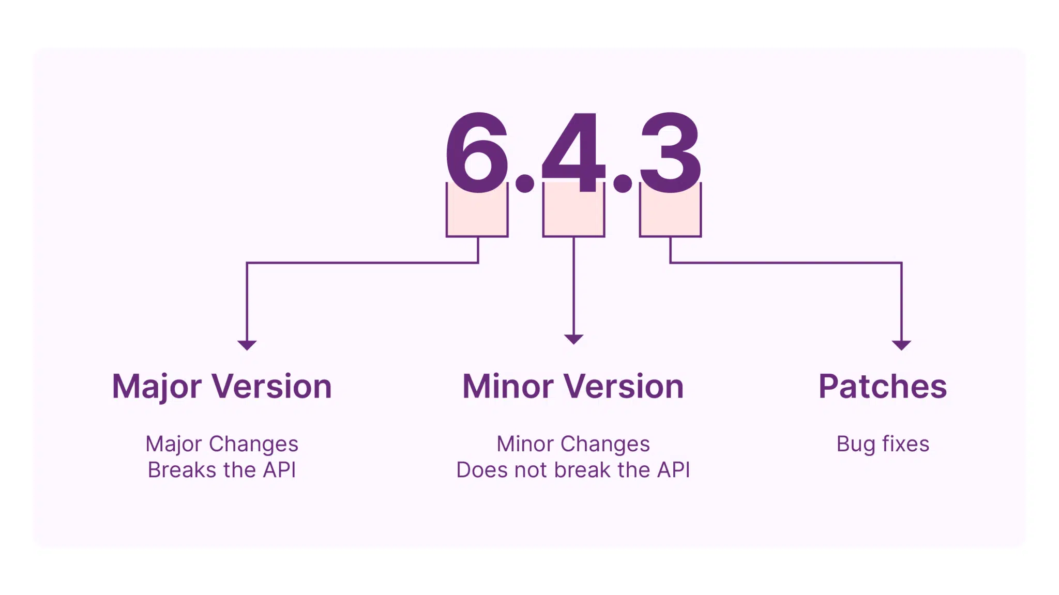

Slide 31
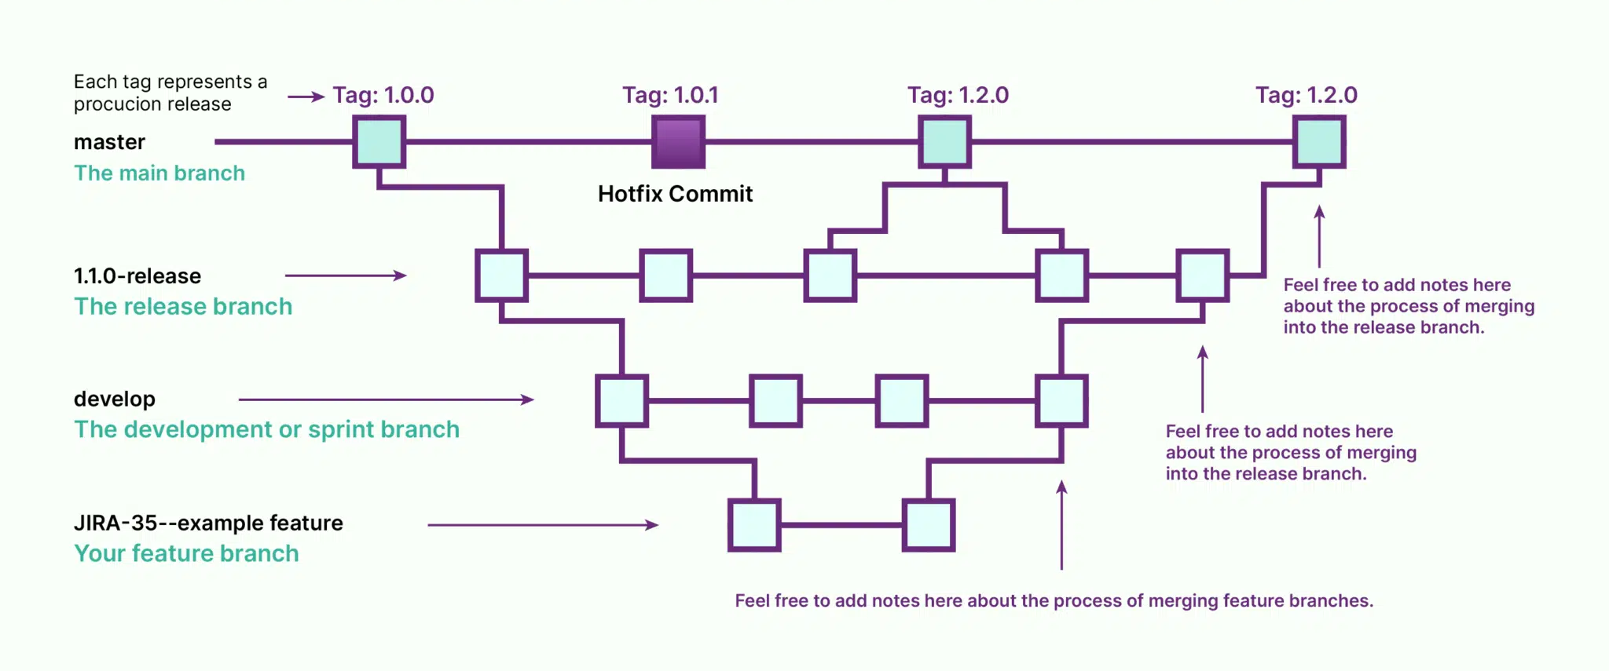

Slide 32
More on semantic versioning semver.org

Slide 33



tam_vit
tam_vit

